Slide 1
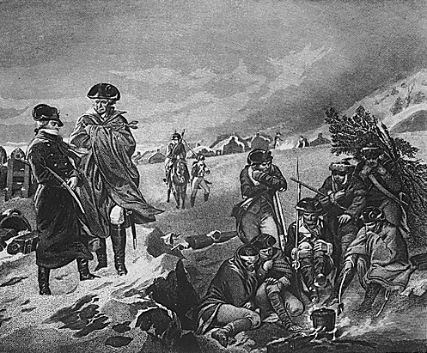

Teaching and Training

Slide 2
References
Army Regulation 20-1,
Inspector General Activities
and Procedures, Chapter 4
The Teaching and Training Guide

Slide 3
Terminal Learning Objective
Advance Sheets Page 12
Action: Conduct teaching and training throughout a command or organization.
Conditions: Given Army Regulation 20-1, The Teaching and Training Guide, and classroom instruction.
Standard: Describe how IGs can conduct teaching and training as both an embedded and independent function. The description must include: a) The IG's approach to teaching and training while performing the Inspections, Assistance, and Investigations functions.; b) The purpose and goals of IG-to-IG Staff Assistance Visits; c) The purpose and objectives of a Readiness Assistance Visit; and d) The seven steps of the Readiness Assistance Visit and their outputs – (1) Research, (2) Concept Development, (3) Detailed Planning, (4) Preparation and Rehearsal, (5) Conduct the Readiness Assistance Visit, (6) Results to the Directing Authority, (7) Follow-Up

Slide 4
Enabling Learning Objectives
Advance Sheets Page 12
ELO
1. Describe how IGs can conduct teaching and training as both an embedded and independent function.
2. Describe the purpose and goals of an IG-to-IG Staff Assistance Visit.
3. Describe the purpose and goals of a Readiness Assistance Visit.
4. Describe the seven steps of a Readiness Assistance Visit and their outputs.

Slide 5
Safety and Environmental
Safety Requirements: No other specific safety requirements are unique to this block of instruction per DA PAM 385-30, Risk Management, dated 2 December 2014.
Risk Assessment Level: Low in accordance with TRADOC Regulation 385-2, U.S. Army Training and Doctrine Command Safety and Occupational Health Program, dated 14 June 2024.
Environmental Considerations: None in accordance with AR 200-1, Environmental Protection and Enhancement, dated 13 December 2007, and ATP 3-34.5, Environmental Considerations, dated January 2024.

Slide 6
Teaching and Training
"The Fourth Pillar"
ELO
1
Increases readiness and warfighting capabilities
INSPECTIONS
TEACHING
AND
TRAINING
ASSISTANCE
INVESTIGATIONS
Embedded and Independent Function

Slide 7
Teaching and Training as an Embedded Function
ELO
1
Teaching and training is a foundational component of “the BIG three”
  Inspections
  Assistance
  Investigations

Slide 8
Teaching and Training as an Embedded Function
Inspections:
Proactively resolves issues that affect unit readiness and warfighting capability
Conducting inspections "make units better"
Instructive Inspections Principle - No inspection is complete if the units or agencies inspected have not learned about goals and standards and how to achieve them
The Teaching and Training Guide, Sect 2-1

Slide 9
Teaching and Training as an Embedded Function
Assistance:
Render assistance
Help Commanders correct injustices
Eliminate conditions detrimental to the efficiency or reputation of the Army
Record and analyze data for corrective action
Report on the status of the Army
The Teaching and Training Guide, Sect 2-2

Slide 10
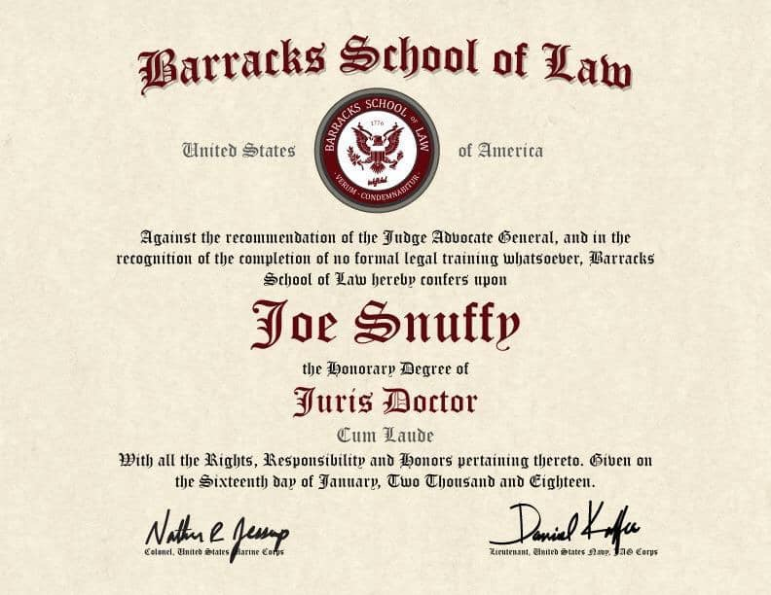
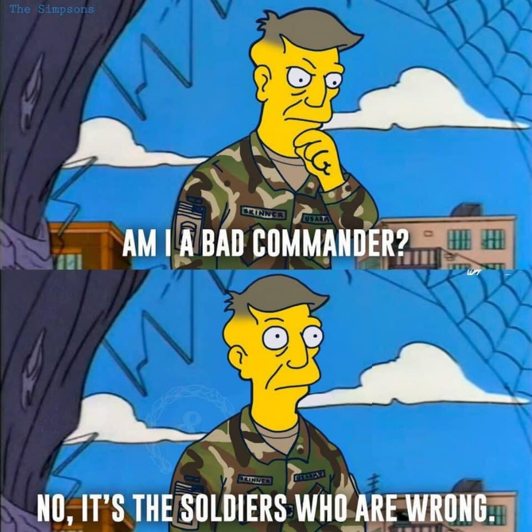
Teaching and Training as an Embedded Function
Assistance:
Explain standards to complainants when they do not know or understand current policy.
Teach and train the chain of command on standards / help commanders correct injustices.
The Teaching and Training Guide, Sect 2-2
Notes:
-

Slide 11
Teaching and Training as an Embedded Function
Investigations:
Resolve allegations of impropriety
Unwavering commitment to standards
Focus on Army values
Fairness and equity to all personnel
Protect the best interests of the Army
The Teaching and Training Guide, Sect 2-3

Slide 12

Teaching and Training as an Embedded Function
Investigations:
Explain standards to subjects,
suspects, and witnesses
Teaching and Training found
in ROI / ROII recommendations
Opportunities found in
"Other Matters"
Perceptions affect readiness
The Teaching and Training Guide, Sect 2-3

Slide 13
Teaching and Training as an Independent Function
ELO
1
Direct Teaching and Training Opportunities
IG-to-IG Staff Assistance Visits
Readiness Assistance Visits

Slide 14
Teaching and Training as an Independent Function
Direct Teaching and Training Opportunities:
Local company commander and 1SG courses
Officer and NCO Professional Development Programs
Newcomer / in-processing briefings
Pre-command courses
Post change-of-command office calls
Local newspapers and unit newsletters
IG Leader Guides
Initial-Entry Training (IET) IG orientation
Theater orientation programs
IG
Concept
and
System
The Teaching and Training Guide, Sect 3-1

Slide 15
Teaching and Training as an Independent Function
IG-to-IG Staff Assistance Visits:
What are they?
Review a sampling of completed IGARS
Review a sampling of IGARS trends
Review recent IG Inspection reports
Review ROIs / ROIIs
Verify compliance with Intelligence Oversight
Provide ideas on file management
The Teaching and Training Guide, Sect 3-2

Slide 16
Teaching and Training as an Independent Function
ELO
2
IG-to-IG Staff Assistance Visits:
Purpose and goals:
Mentorship opportunities
Share best practices
Provide updates to IG policy and doctrine
The Teaching and Training Guide, Sect 3-2

Slide 17
Teaching and Training as an Independent Function
ELO
3
Readiness Assistance Visits:
Purpose and goals – Allow IGs to assist Operating Force (Corps / Divisions) units by:
Teaching incoming personnel how to inspect their organization
Teaching the unit about the Organizational Inspection Program
Assisting a unit in re-establishing systems
The Teaching and Training Guide, Sect 3-3

Slide 18
Teaching and Training as an Independent Function
Readiness Assistance Visits:
Are NOT Inspections…
and they are NOT a substitute for
Initial Command Inspections or
Subsequent Command Inspections
The Teaching and Training Guide, Sect 3-3

Slide 19
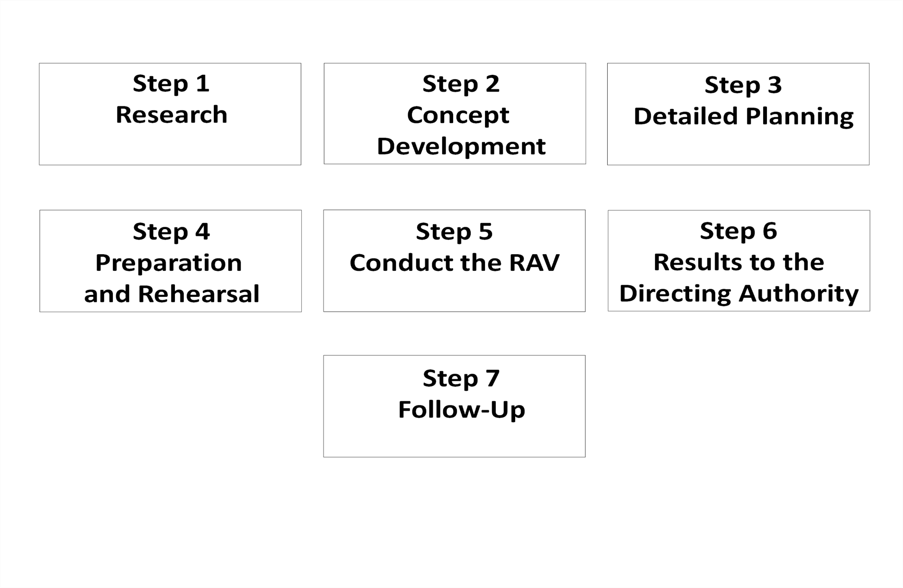
Readiness Assistance Visit
RAV Seven-Step Process
The Teaching and Training Guide, Sect 3-3, page 3-3-4

Slide 20
Readiness Assistance Visit
Step 1:
RESEARCH
Purpose
Objectives
Determine the nature of the unit(s) and what systems require re-establishment:
Review higher commander's guidance
Review METL
Review the regulatory requirements for execution
Review previous Command and Staff Inspections
Consult SMEs required to assist the unit
Assemble and review existing unit inspection checklists

Slide 21
Readiness Assistance Visit
Step 2:
DEVELOP CONCEPT
Concept Memo
The RAV concept is the blueprint for your RAV plan and forms the basis of your concept-approval briefing.
The concept is nothing more than a plan that outlines – in general – how the IG team plans to accomplish the RAV.
The concept plan can take the form of a memorandum or a slide briefing – or both (physical output of this step).

Slide 22
Readiness Assistance Visit
The RAV
must have a
Directive
Step 2:
DEVELOP CONCEPT
Concept Memo
Directive
The Concept should include, at a minimum:
    Purpose (from the Research step)
    Objectives (from the Research step)
    Scope (the team’s task organization and overall focus)
    Required Resources (specify SMEs by area of expertise)
    Timeline (outline key milestone dates)
    Notification (explain how the teams plans to notify units)
The directive gives the IG the authority to assemble a
Team and conduct the RAV.

Slide 23
Readiness Assistance Visit
Step 3:
DETAILED PLANNING
Methodology
Notification Memo
Detailed Plan
The Methodology is the plan for physically conducting the RAV. It may include:
    Task Organization of RAV Team (includes functional specialty augmentees)
    Standard Methodology
    Sample Itinerary
The Notification Memorandum and the Detailed RAV Plan anticipate and answer the questions the unit may ask.

Slide 24
Readiness Assistance Visit
Step 4:
PREPARE & REHEARSE
Augmentee duties
Info-gathering tools
Briefing formats
Equipment Inventory
Command-climate
Rehearsals
Conduct additional research as required
Define augmentees’ responsibilities
Train and rehearse augmentees
Develop information-gathering tools
Develop the in-briefing and out-briefing slide format
Develop OIP training material (classes for systems)
Rehearse, Rehearse, Rehearse!!

Slide 25
Readiness Assistance Visit
Step 5:
CONDUCT THE RAV
The out-brief
is NOT an
IG product !!
Out-brief
Execute your methodology and itinerary with the unit / staff:
  Conduct an in-briefing to inform unit leaders of the RAV purpose and scope (develop a standard in-brief for all units)
  RAV team members must determine the proficiency and knowledge level of the functional-area representative and tailor the training accordingly and assist them with developing a checklist that will help them see themselves
  Assist units in developing an out-briefing they will use to out-brief THEIR commander on what THEY inspected

Slide 26
Readiness Assistance Visit
Step 6:
RESULTS TO DIRECTING AUTHORITY
Out-briefing book with detailed results
Providing the results to the directing authority may be a formal or informal event depending on their guidance
The RAV team must prepare a briefing book for the commanding general that includes the same slides the unit(s) briefed to their commander along with any completed inspection checklists

Slide 27
Readiness Assistance Visit
Step 7:
FOLLOW UP
Schedule a follow-up visit about 6-8 weeks later
Normally a one-day event (does not need to include the entire original team)
Coordinate with and conduct follow-up on an individual basis (and as needed) for additional training
Once RAV has met its goals, the IG should contact the unit(s) commander to close out
The Command IG should also close out the RAV with the CG

Slide 28
Readiness Assistance Visit
ELO
4
RAV Seven-Step Process
Purpose
Objectives
Concept Memo
Directive
Methodology
Notification Memo
Detailed RAV Plan
Augmentee duties
Info-gathering tools
Briefing formats
Equipment Inventory
Command-climate
Rehearsals
Out-briefing
Out-briefing book with detailed results

Slide 29
ELO Check on Learning
ELO 1: Describe how IGs can conduct teaching and training as both an embedded and independent function.
  Embedded within the Big Three (Inspections, Assistance, and Investigations)
  Independently through Direct Teaching and Training Opportunities, IG-to-IG Staff Assistance Visits, and Readiness Assistance Visits

Slide 30
ELO Check on Learning
ELO 2: Describe the purpose and goals of an IG-to-IG Staff Assistance Visit?
  Mentorship opportunities
  Share best practices
  Provide current updates to IG policy and doctrine
ELO 3: Describe the purpose and goals of a Readiness Assistance Visit?
  Teach units about the OIP
  Teach units how to inspect their organization
  Assist units in re-establishing functional systems

Slide 31
ELO Check on Learning
ELO 4: Describe the seven steps of a RAV and their outputs.
Purpose
Objectives
Concept Memo
Directive
Methodology
Notification Memo
Detailed RAV Plan
Augmentee duties
Info-gathering tools
Briefing formats
Equipment Inventory
Command-climate
Rehearsals
Out-briefing
Out-briefing book with detailed results

Slide 32
TLO Check on Learning
Action: Conduct teaching and training throughout a command or organization.
Conditions: Given Army Regulation 20-1, The Teaching and Training Guide, and classroom instruction.
Standard: Describe how IGs can conduct teaching and training as both an embedded and independent function. The description must include: a) The IG's approach to teaching and training while performing the Inspections, Assistance, and Investigations functions.; b) The purpose and goals of IG-to-IG Staff Assistance Visits; c) The purpose and objectives of a Readiness Assistance Visit; and d) The seven steps of the Readiness Assistance Visit and their outputs – (1) Research, (2) Concept Development, (3) Detailed Planning, (4) Preparation and Rehearsal, (5) Conduct the Readiness Assistance Visit, (6) Results to the Directing Authority, (7) Follow-Up

Slide 33
Summary
During the Teaching and Training Block of Instruction we:
Described how IGs can conduct teaching and training as both an embedded and independent function.
Described the purpose and goals of an IG-to-IG Staff Assistance Visit.
Described the purpose and objectives of a Readiness Assistance Visit.
Described the seven steps of a Readiness Assistance Visit and their outputs.

Slide 34

Questions?

